Slide 1
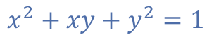
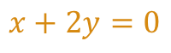
$$x^{2}+xy+y^{2}=1$$
$$x+2y=0$$

Slide 2
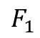
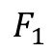
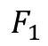
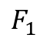
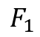
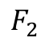
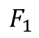
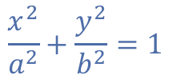
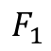
$$F_{1}$$
$$F_{1}$$
$$F_{1}$$
$$F_{1}$$
$$F_{1}$$
$$F_{2}$$
$$F_{1}$$
$$F_{1}$$
$$\frac{x^{2}}{a^{2}}+\frac{y^{2}}{b^{2}}=1$$

Slide 3
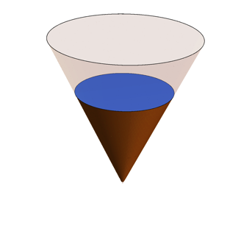
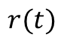
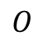
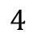
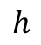
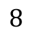
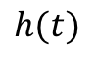
$$h$$
$$8$$
$$4$$
$$h(t)$$
$$r(t)$$
$$O$$

Slide 4
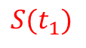
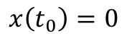
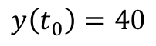
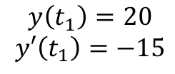
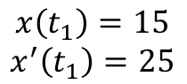
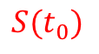
North
$$y\left(t_{0}\right)=40$$
$$y\left(t_{1}\right)=20$$
$$y′\left(t_{1}\right)=−15$$
$$S(t_{0})$$
$$S(t_{1})$$
$$x\left(t_{0}\right)=0$$
$$x\left(t_{1}\right)=15$$
$$x^{′}\left(t_{1}\right)=25$$
East

Slide 6
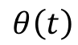
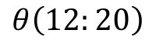
$$θ\left(12:20\right)$$
$$θ\left(t\right)$$

Slide 7
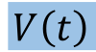
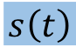
$$V\left(t\right)$$
$$s\left(t\right)$$

Slide 8
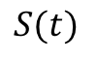
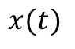
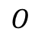
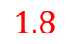
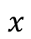
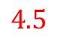
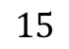
$$4.5$$
$$1.8$$
$$O$$
$$x(t)$$
$$15$$
$$x$$
$$S(t)$$

Slide 9
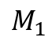
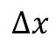

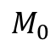
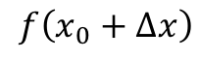
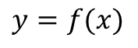
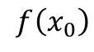
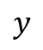
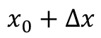
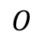
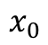
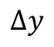
$$y$$
$$y=f(x)$$
$$M_{1}$$
$$f\left(x_{0}+Δx\right)$$
$$Δy$$
$$f\left(x_{0}\right)$$
$$M_{0}$$
$$Δx$$
$$O$$
$$x_{0}$$
$$x_{0}+Δx$$
$$x$$

Slide 10
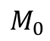
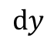
$$y$$
$$y=f(x)$$
$$M_{1}$$
$$f\left(x_{0}+Δx\right)$$
$$Δy$$
$$dy$$
$$f\left(x_{0}\right)$$
$$M_{0}$$
$$Δx$$
$$O$$
$$x_{0}$$
$$x_{0}+Δx$$
$$x$$

